Slide 1
BUSINESS DATA ANALYTICS

Slide 2
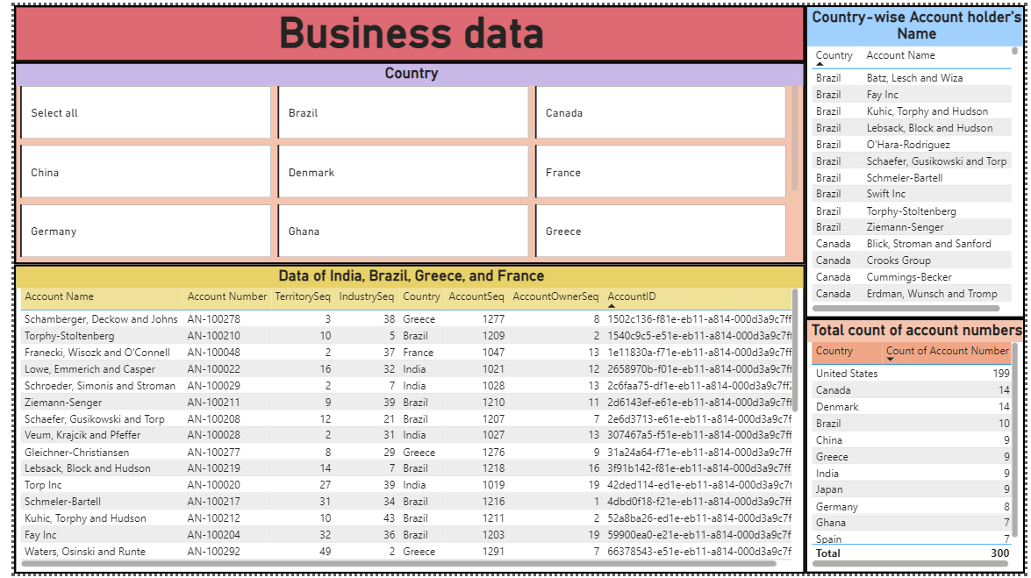

Slide 3
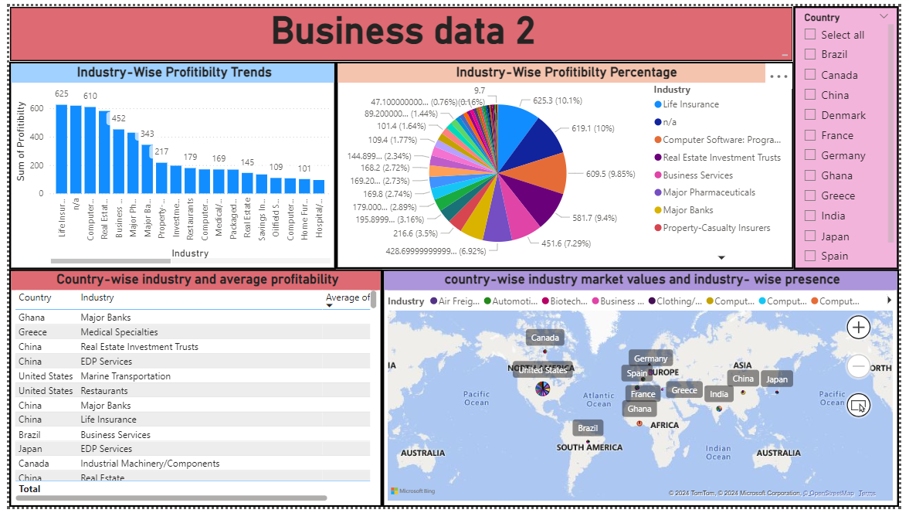

Slide 4
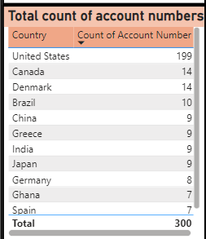
Represent the data, which includes the total count of account numbers against the country, in a tabular format.
United States Dominance: The United States has the highest number of accounts, significantly surpassing other countries.
Canada and Denmark Tie: Both Canada and Denmark have the same number of accounts (14).
Mid-Tier Group: Brazil, China, Greece, India, and Japan have a similar number of accounts (9-10).
Small European Presence: Germany, Ghana, Spain, and France have relatively lower account counts compared to the top countries.
Overall, the data suggests a concentrated presence in the United States with a more distributed presence across other countries.

Slide 5
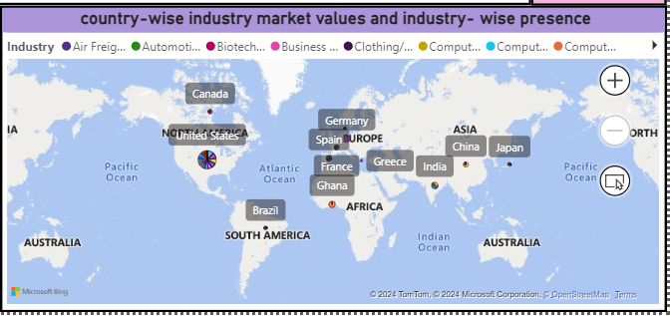
Country-wise Industry Market Values and Industry-wise Presence
Regional Dominance: North America, particularly the United States, appears to have a strong presence across various industries.
Emerging Markets: Asia, specifically China and India, are emerging as significant markets for multiple industries.
Profitability: in USA, life insurance has the highest and biotechnology has the lowest profitability.
Overall, the data suggests a concentrated presence of various industries in United States with a more distributed presence across other countries.

Slide 6
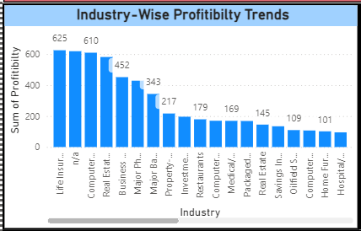
Industry-wise profitability trends
Top Performers: Life Insurance and Computer Software: Programming are the most profitable industries by a substantial margin.
Mid-Tier: Real Estate, Business Services, Investment Trusts, and Major Pharmaceuticals form a mid-tier group with moderate profitability.
Lower Tier: The majority of industries fall into this category, with profitability levels significantly lower than the top performers.
Overall, there is significant disparity in profitability across industries.

Slide 7
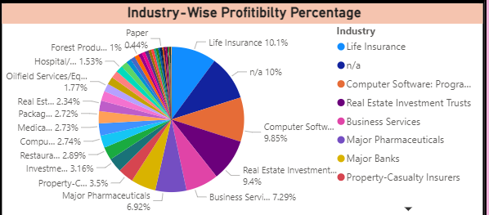
Industry-wise profitability percentage
Top Performers: Life Insurance and Computer Software: Programming stand out as the most profitable sectors with substantial pie segments.
Mid-Tier: Industries like Real Estate Investment Trusts, Business Services, and Major Pharmaceuticals occupy a middle ground in terms of profitability.
Lower Tier: The majority of industries fall into this category, characterized by smaller pie segments and lower profitability percentages.
Diversified commercial services have the lowest share of profitability.
The data reveals a significant disparity in profitability percentages across various industries.

